Slide 1
Searching
Searching refers to the operation for finding something
We have an array DATA, specific ITEM of information
Searching will give us the LOC of ITEM
Successful
-ITEM appears in DATA
Unsuccessful
-ITEM does not appears in DATA
35=?---------------Successful
100=?--------------Unsuccessful
10
25
35
68
78
15

Slide 2
Searching Algorithm
Depends on the way the information in DATA is organized.
Linear Search: when the data is unsorted or sorted
Binary Search: when the data is sorted only!!!
Linear Search
Binary Search
10
25
35
68
78
15
10
15
25
35
68
75

Slide 3
Linear Search
We have an array DATA with N elements.
We have to find the LOC of ITEM(Say ITEM=68)
Working Process:
-check element one by one.
-DATA[1]=ITEM ???
-If YES then OK.
-Otherwise DATA[2]=ITEM ???
……So on.
10
25
35
68
78
15

Slide 4
Linear Search
1st: K=1 DATA[1]=10
68!=10 so K=2
2nd: K=2 DATA[2]=25
68!=25 so K=3
3rd: K=3 DATA[3]=35
68!=35 so K=4
4th: K=4 DATA[4]=68
68==68
So LOC=K=4
Write: ITEM found at
Location 4
K:=1 and LOC=0.
Repeat Steps 3 and 4 while K<=N
If ITEM=DATA[K],then LOC:=K
Set K:=K+1
If LOC=0 then
-Write :ITEM is not Found
6. Else
-Write : ITEM Found at LOC
7.Exit.
10
25
35
68
78
15

Slide 5
Binary Search
We have an array DATA with n elements.
Data or information must be sorted.
Binary search is efficient than linear search.
Think of a telephone directory
----you need to find Nazim
Do you need to search a name from A to Z
Obviously not!!!!!
10
25
35
68
78
15

Slide 6
Binary Search
Conditions:
Data or information must be sorted.
Data or information must be into an array
10
105
25
68
78
85
Applicable ????
NO

Slide 7
Binary Search
Conditions:
Data or information must be sorted.
Data or information must be into an array
10
105
25
68
78
85
10
15
25
68
78
85
Applicable ????
Yes

Slide 8
Binary Search
We have an array DATA with N elements.
We have to find the LOC of ITEM(Say ITEM=60)
BEG= 1st Position=1
END= Last Position=10
10 | 20 | 30 | 40 | 50 | 60 | 70 | 80 | 90 | 100

Slide 9
Binary Search
10 | 20 | 30 | 40 | 50 | 60 | 70 | 80 | 90 | 100
We calculate the MID position.
MID=INT((BEG+END)/2)
Pick up the DATA[MID] and Compare with ITEM.
If ITEM>DATA[MID] then we search the right half
Reset BEG:=MID+1
If ITEM<DATA[MID] then we search the left half
Reset END:=MID-1
If ITEM=DATA[MID] then search Complete.
Otherwise Not found.

Slide 10
Binary Search
10 | 20 | 30 | 40 | 50 | 60 | 70 | 80 | 90 | 100
Set LOC=0 MID:=INT((BEG+END)/2
Repeat Steps 3 and 4 while BEG<=END
and DATA[MID]!=ITEM
3. If ITEM>DATA[MID]
Set BEG:=MID+1
Else: Set END:=MID-1
4. MID:=INT((BEG+END)/2
5. IF DATA[MID]=ITEM
Set LOC:=MID
Else LOC:=NULL;
6 .Exit.
BEG=1, END=10, MID=5
1st: DATA[MID]=DATA[5]=50
50!=60
and 60>50
So
BEG=MID+1=5+1=6
END=10
MID:=8

Slide 11
Binary Search
10 | 20 | 30 | 40 | 50 | 60 | 70 | 80 | 90 | 100
10 | 20 | 30 | 40 | 50 | 60 | 70 | 80 | 90 | 100
Set LOC=0 MID:=INT((BEG+END)/2
Repeat Steps 3 and 4 while BEG<=END
and DATA[MID]!=ITEM
3. If ITEM>DATA[MID]
Set BEG:=MID+1
Else: Set END:=MID-1
4. MID:=INT((BEG+END)/2
5. IF DATA[MID]=ITEM
Set LOC:=MID
Else LOC:=NULL;
6 .Exit.
BEG=6, END=10, MID=8
2st: DATA[MID]=DATA[8]=80
80!=60
and 60<80
So
END=MID-1=8-1=7
BEG=6
MID:=6

Slide 12
Binary Search
10 | 20 | 30 | 40 | 50 | 60 | 70 | 80 | 90 | 100
10 | 20 | 30 | 40 | 50 | 60 | 70 | 80 | 90 | 100
10 | 20 | 30 | 40 | 50 | 60 | 70 | 80 | 90 | 100
Set LOC=0 MID:=INT((BEG+END)/2
Repeat Steps 3 and 4 while BEG<=END
and DATA[MID]!=ITEM
3. If ITEM>DATA[MID]
Set BEG:=MID+1
Else: Set END:=MID-1
4. MID:=INT((BEG+END)/2
5. IF DATA[MID]=ITEM
Set LOC:=MID
Else LOC:=NULL;
6 .Exit.
BEG=6, END=7, MID=6
3rd: DATA[MID]=DATA[6]=60
60=60
So
LOC=6

Slide 13
Insertion Sort
Insertion sort is a simple sorting algorithm that is appropriate for small inputs.
Most common sorting technique used by card players.
The list is divided into two parts: sorted and unsorted.
In each pass, the first element of the unsorted part is picked up, transferred to the sorted sublist, and inserted at the appropriate place.
A list of n elements will take at most n-1 passes to sort the data.

Slide 14
Insertion Sort
To insert 12, we need to make room for it by moving first 36 and then 24.
6
10
24
36
12

Slide 15
Insertion Sort
6
10
24
36
12

Slide 16
Insertion Sort
6
10
24
36
12

Slide 17
Insertion Sort
input array
5 2 4 6 1 3
at each iteration, the array is divided in two sub-arrays:
left sub-array
right sub-array
sorted
unsorted

Slide 18
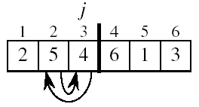
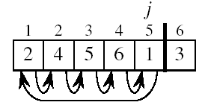
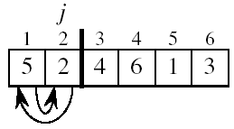
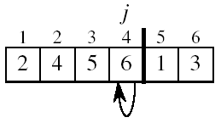
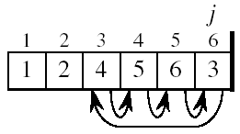
Insertion Sort

Slide 19
One step of insertion sort
sorted
next to be inserted
3
4
7
12
14
14
20
21
33
38
10
55
9
23
28
16
temp
less than 10
10
3
4
7
10
12
14
14
20
21
33
38
55
9
23
28
16
sorted

Slide 20
Example of insertion sort
8
2
4
9
3
6
2
8
4
9
3
6
2
4
8
9
3
6
2
4
8
9
3
6
2
3
4
8
9
6
2
3
4
6
8
9
done

Slide 21
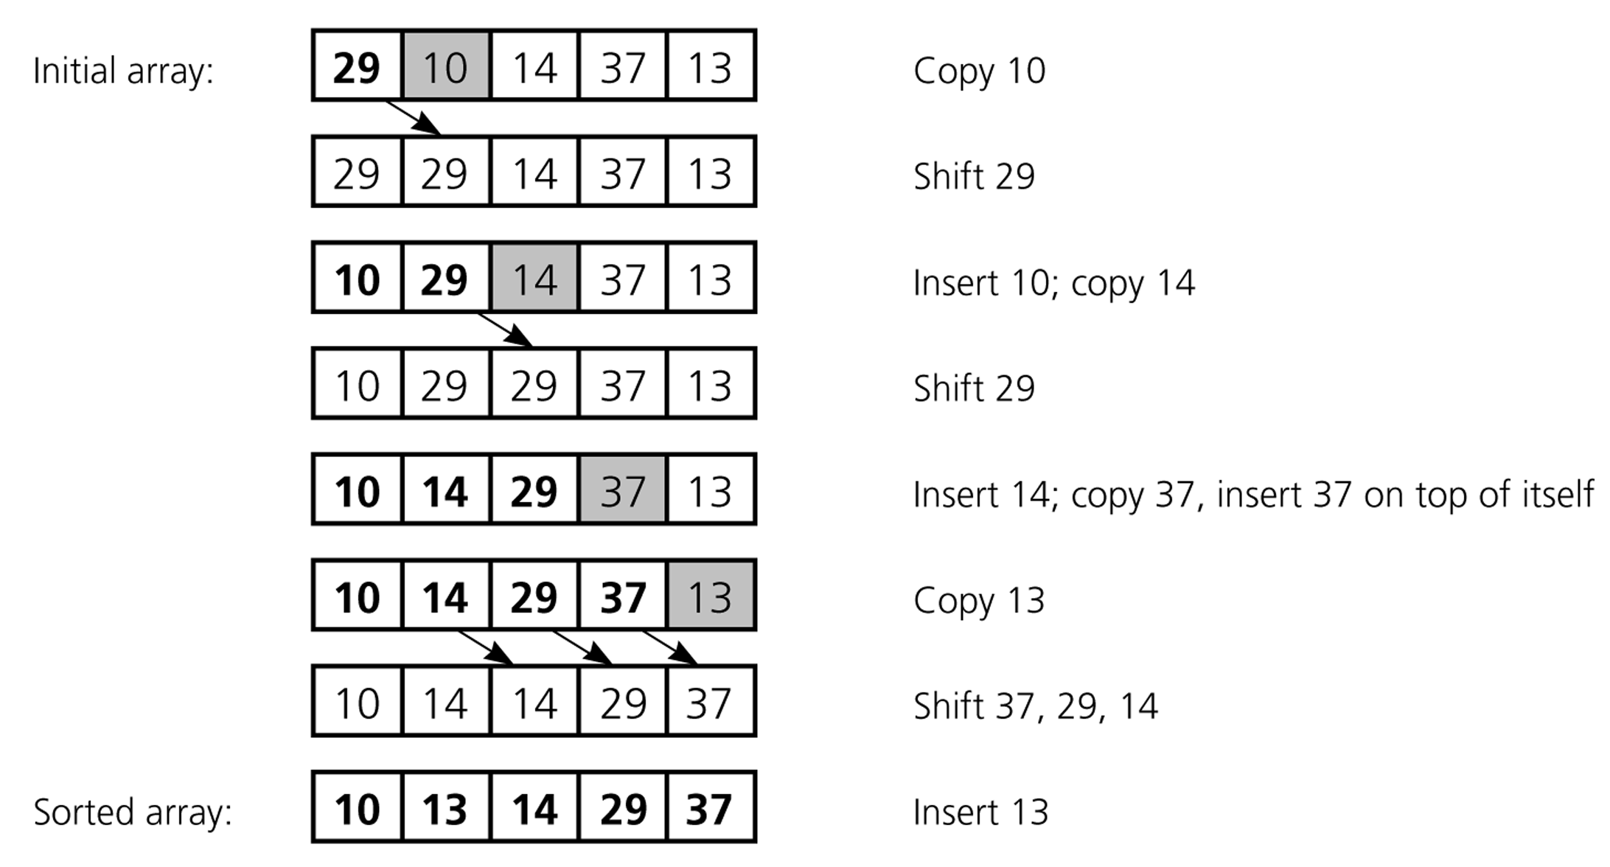
An insertion sort of an array of five integers

Slide 22
Algorithm: Insertion_Sort( List , N)
Here List is the list of items and N is the total number of items.
Repeat steps 2 to 7 for I = 2…..N
Set Key := List [ I ]
Set J := I - 1
4. Repeat steps 5 and 6 while j ≥ 1 and List[ J ] > Key
5. List [ J+1 ] := List [ J ]
6. Decrement J
Set List [ J+1] := Key;
End.

Slide 23
An Example: Insertion Sort
InsertionSort(A, n) { for i = 2 to n { key = A[i] j = i - 1; while (j > 0) and (A[j] > key) { A[j+1] = A[j] j = j - 1 } A[j+1] = key }
}

Slide 24
An Example: Insertion Sort
30
10
40
20
i = ∅ j = ∅ key = ∅ A[j] = ∅ A[j+1] = ∅
1
2
3
4
InsertionSort(A, n) { for i = 2 to n { key = A[i] j = i - 1; while (j > 0) and (A[j] > key) { A[j+1] = A[j] j = j - 1 } A[j+1] = key }
}

Slide 25
An Example: Insertion Sort
30
10
40
20
i = 2 j = 1 key = 10 A[j] = 30 A[j+1] = 10
1
2
3
4
InsertionSort(A, n) { for i = 2 to n { key = A[i] j = i - 1; while (j > 0) and (A[j] > key) { A[j+1] = A[j] j = j - 1 } A[j+1] = key }
}

Slide 26
An Example: Insertion Sort
30
30
40
20
i = 2 j = 1 key = 10 A[j] = 30 A[j+1] = 30
1
2
3
4
InsertionSort(A, n) { for i = 2 to n { key = A[i] j = i - 1; while (j > 0) and (A[j] > key) { A[j+1] = A[j] j = j - 1 } A[j+1] = key }
}

Slide 27
An Example: Insertion Sort
30
30
40
20
i = 2 j = 1 key = 10 A[j] = 30 A[j+1] = 30
1
2
3
4
InsertionSort(A, n) { for i = 2 to n { key = A[i] j = i - 1; while (j > 0) and (A[j] > key) { A[j+1] = A[j] j = j - 1 } A[j+1] = key }
}

Slide 28
An Example: Insertion Sort
30
30
40
20
i = 2 j = 0 key = 10 A[j] = ∅ A[j+1] = 30
1
2
3
4
InsertionSort(A, n) { for i = 2 to n { key = A[i] j = i - 1; while (j > 0) and (A[j] > key) { A[j+1] = A[j] j = j - 1 } A[j+1] = key }
}

Slide 29
An Example: Insertion Sort
30
30
40
20
i = 2 j = 0 key = 10 A[j] = ∅ A[j+1] = 30
1
2
3
4
InsertionSort(A, n) { for i = 2 to n { key = A[i] j = i - 1; while (j > 0) and (A[j] > key) { A[j+1] = A[j] j = j - 1 } A[j+1] = key }
}

Slide 30
An Example: Insertion Sort
10
30
40
20
i = 2 j = 0 key = 10 A[j] = ∅ A[j+1] = 10
1
2
3
4
InsertionSort(A, n) { for i = 2 to n { key = A[i] j = i - 1; while (j > 0) and (A[j] > key) { A[j+1] = A[j] j = j - 1 } A[j+1] = key }
}

Slide 31
An Example: Insertion Sort
10
30
40
20
i = 3 j = 0 key = 10 A[j] = ∅ A[j+1] = 10
1
2
3
4
InsertionSort(A, n) { for i = 2 to n { key = A[i] j = i - 1; while (j > 0) and (A[j] > key) { A[j+1] = A[j] j = j - 1 } A[j+1] = key }
}

Slide 32
An Example: Insertion Sort
10
30
40
20
i = 3 j = 0 key = 40 A[j] = ∅ A[j+1] = 10
1
2
3
4
InsertionSort(A, n) { for i = 2 to n { key = A[i] j = i - 1; while (j > 0) and (A[j] > key) { A[j+1] = A[j] j = j - 1 } A[j+1] = key }
}

Slide 33
An Example: Insertion Sort
10
30
40
20
i = 3 j = 0 key = 40 A[j] = ∅ A[j+1] = 10
1
2
3
4
InsertionSort(A, n) { for i = 2 to n { key = A[i] j = i - 1; while (j > 0) and (A[j] > key) { A[j+1] = A[j] j = j - 1 } A[j+1] = key }
}

Slide 34
An Example: Insertion Sort
10
30
40
20
i = 3 j = 2 key = 40 A[j] = 30 A[j+1] = 40
1
2
3
4
InsertionSort(A, n) { for i = 2 to n { key = A[i] j = i - 1; while (j > 0) and (A[j] > key) { A[j+1] = A[j] j = j - 1 } A[j+1] = key }
}

Slide 35
An Example: Insertion Sort
10
30
40
20
i = 3 j = 2 key = 40 A[j] = 30 A[j+1] = 40
1
2
3
4
InsertionSort(A, n) { for i = 2 to n { key = A[i] j = i - 1; while (j > 0) and (A[j] > key) { A[j+1] = A[j] j = j - 1 } A[j+1] = key }
}

Slide 36
An Example: Insertion Sort
10
30
40
20
i = 3 j = 2 key = 40 A[j] = 30 A[j+1] = 40
1
2
3
4
InsertionSort(A, n) { for i = 2 to n { key = A[i] j = i - 1; while (j > 0) and (A[j] > key) { A[j+1] = A[j] j = j - 1 } A[j+1] = key }
}

Slide 37
An Example: Insertion Sort
10
30
40
20
i = 4 j = 2 key = 40 A[j] = 30 A[j+1] = 40
1
2
3
4
InsertionSort(A, n) { for i = 2 to n { key = A[i] j = i - 1; while (j > 0) and (A[j] > key) { A[j+1] = A[j] j = j - 1 } A[j+1] = key }
}

Slide 38
An Example: Insertion Sort
10
30
40
20
i = 4 j = 2 key = 20 A[j] = 30 A[j+1] = 40
1
2
3
4
InsertionSort(A, n) { for i = 2 to n { key = A[i] j = i - 1; while (j > 0) and (A[j] > key) { A[j+1] = A[j] j = j - 1 } A[j+1] = key }
}

Slide 39
An Example: Insertion Sort
10
30
40
20
i = 4 j = 2 key = 20 A[j] = 30 A[j+1] = 40
1
2
3
4
InsertionSort(A, n) { for i = 2 to n { key = A[i] j = i - 1; while (j > 0) and (A[j] > key) { A[j+1] = A[j] j = j - 1 } A[j+1] = key }
}

Slide 40
An Example: Insertion Sort
10
30
40
20
i = 4 j = 3 key = 20 A[j] = 40 A[j+1] = 20
1
2
3
4
InsertionSort(A, n) { for i = 2 to n { key = A[i] j = i - 1; while (j > 0) and (A[j] > key) { A[j+1] = A[j] j = j - 1 } A[j+1] = key }
}

Slide 41
An Example: Insertion Sort
10
30
40
20
i = 4 j = 3 key = 20 A[j] = 40 A[j+1] = 20
1
2
3
4
InsertionSort(A, n) { for i = 2 to n { key = A[i] j = i - 1; while (j > 0) and (A[j] > key) { A[j+1] = A[j] j = j - 1 } A[j+1] = key }
}

Slide 42
An Example: Insertion Sort
10
30
40
40
i = 4 j = 3 key = 20 A[j] = 40 A[j+1] = 40
1
2
3
4
InsertionSort(A, n) { for i = 2 to n { key = A[i] j = i - 1; while (j > 0) and (A[j] > key) { A[j+1] = A[j] j = j - 1 } A[j+1] = key }
}

Slide 43
An Example: Insertion Sort
10
30
40
40
i = 4 j = 3 key = 20 A[j] = 40 A[j+1] = 40
1
2
3
4
InsertionSort(A, n) { for i = 2 to n { key = A[i] j = i - 1; while (j > 0) and (A[j] > key) { A[j+1] = A[j] j = j - 1 } A[j+1] = key }
}

Slide 44
An Example: Insertion Sort
10
30
40
40
i = 4 j = 3 key = 20 A[j] = 40 A[j+1] = 40
1
2
3
4
InsertionSort(A, n) { for i = 2 to n { key = A[i] j = i - 1; while (j > 0) and (A[j] > key) { A[j+1] = A[j] j = j - 1 } A[j+1] = key }
}

Slide 45
An Example: Insertion Sort
10
30
40
40
i = 4 j = 2 key = 20 A[j] = 30 A[j+1] = 40
1
2
3
4
InsertionSort(A, n) { for i = 2 to n { key = A[i] j = i - 1; while (j > 0) and (A[j] > key) { A[j+1] = A[j] j = j - 1 } A[j+1] = key }
}

Slide 46
An Example: Insertion Sort
10
30
40
40
i = 4 j = 2 key = 20 A[j] = 30 A[j+1] = 40
1
2
3
4
InsertionSort(A, n) { for i = 2 to n { key = A[i] j = i - 1; while (j > 0) and (A[j] > key) { A[j+1] = A[j] j = j - 1 } A[j+1] = key }
}

Slide 47
An Example: Insertion Sort
10
30
30
40
i = 4 j = 2 key = 20 A[j] = 30 A[j+1] = 30
1
2
3
4
InsertionSort(A, n) { for i = 2 to n { key = A[i] j = i - 1; while (j > 0) and (A[j] > key) { A[j+1] = A[j] j = j - 1 } A[j+1] = key }
}

Slide 48
An Example: Insertion Sort
10
30
30
40
i = 4 j = 2 key = 20 A[j] = 30 A[j+1] = 30
1
2
3
4
InsertionSort(A, n) { for i = 2 to n { key = A[i] j = i - 1; while (j > 0) and (A[j] > key) { A[j+1] = A[j] j = j - 1 } A[j+1] = key }
}

Slide 49
An Example: Insertion Sort
10
30
30
40
i = 4 j = 1 key = 20 A[j] = 10 A[j+1] = 30
1
2
3
4
InsertionSort(A, n) { for i = 2 to n { key = A[i] j = i - 1; while (j > 0) and (A[j] > key) { A[j+1] = A[j] j = j - 1 } A[j+1] = key }
}

Slide 50
An Example: Insertion Sort
10
30
30
40
i = 4 j = 1 key = 20 A[j] = 10 A[j+1] = 30
1
2
3
4
InsertionSort(A, n) { for i = 2 to n { key = A[i] j = i - 1; while (j > 0) and (A[j] > key) { A[j+1] = A[j] j = j - 1 } A[j+1] = key }
}

Slide 51
An Example: Insertion Sort
10
20
30
40
i = 4 j = 1 key = 20 A[j] = 10 A[j+1] = 20
1
2
3
4
InsertionSort(A, n) { for i = 2 to n { key = A[i] j = i - 1; while (j > 0) and (A[j] > key) { A[j+1] = A[j] j = j - 1 } A[j+1] = key }
}

Slide 52
An Example: Insertion Sort
10
20
30
40
i = 4 j = 1 key = 20 A[j] = 10 A[j+1] = 20
1
2
3
4
InsertionSort(A, n) { for i = 2 to n { key = A[i] j = i - 1; while (j > 0) and (A[j] > key) { A[j+1] = A[j] j = j - 1 } A[j+1] = key }
}
Done!

Slide 53
Any Questions
????????

Slide 54
Thanks

